Slide 1
Notes:
Report and manual of Steelton public schools 1891-1894/Pennsylvania Steel Co. paid for school

Slide 2
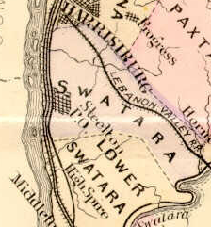

Hygienic School for Colored Children
Notes:
Steelton map

Slide 3
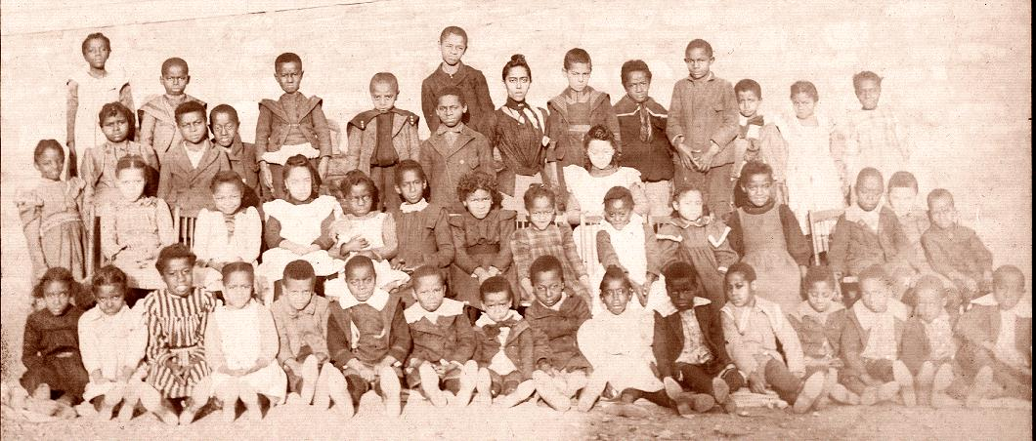
Miss Aura Imes class of 1886-1887
Notes:
The elementary school children and Miss Imes

Slide 4
Notes:
1890 schooling at churches and Odd Fellows Hall

Slide 5
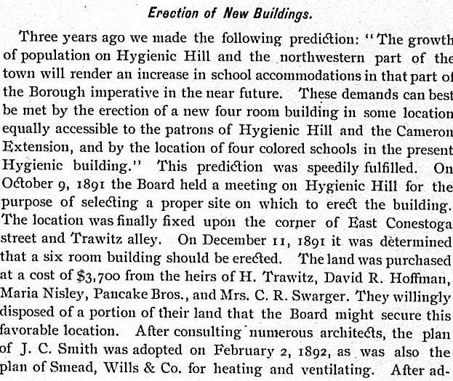
Land purchased for colored school
Notes:
Originally built 1891-1892 school built - John C Smith architect

Slide 6
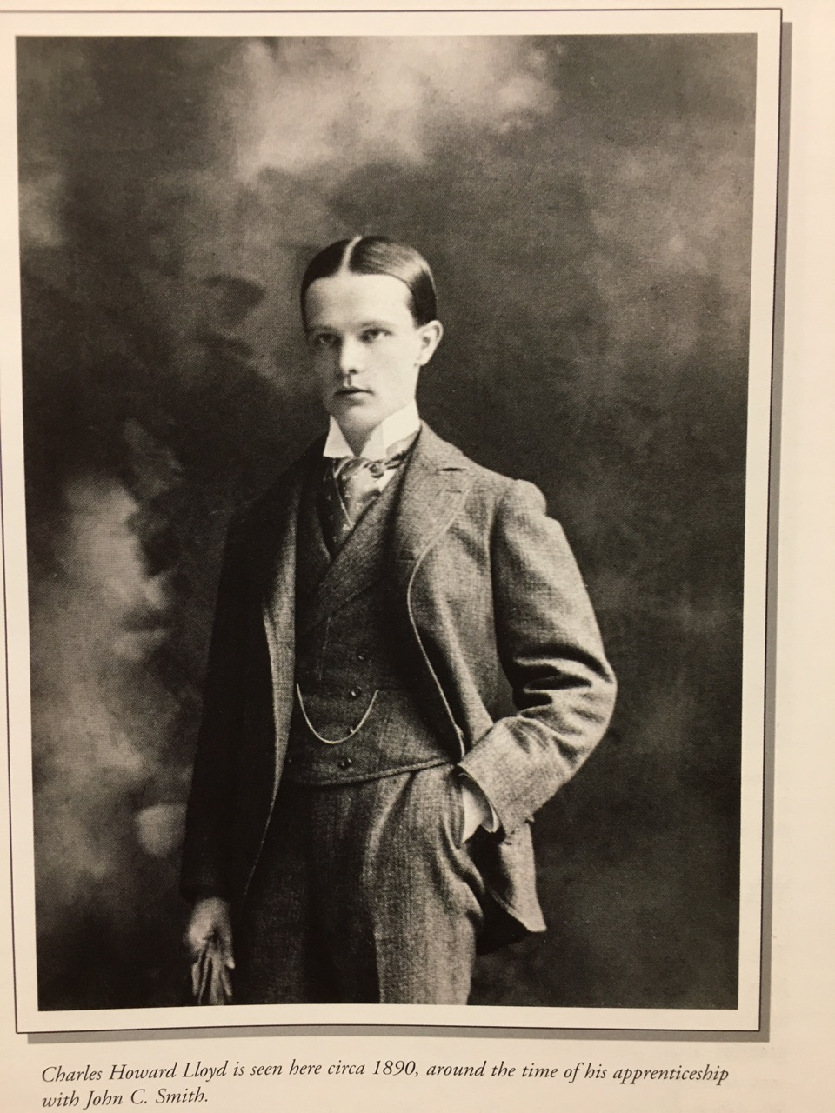
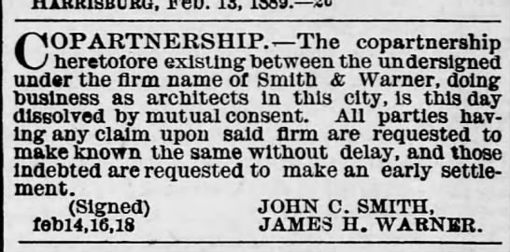
Charles Howard Lloyd
Notes:
Charles Howard Lloyd – 1890 around time of apprenticeship with John C. Smith

Slide 7
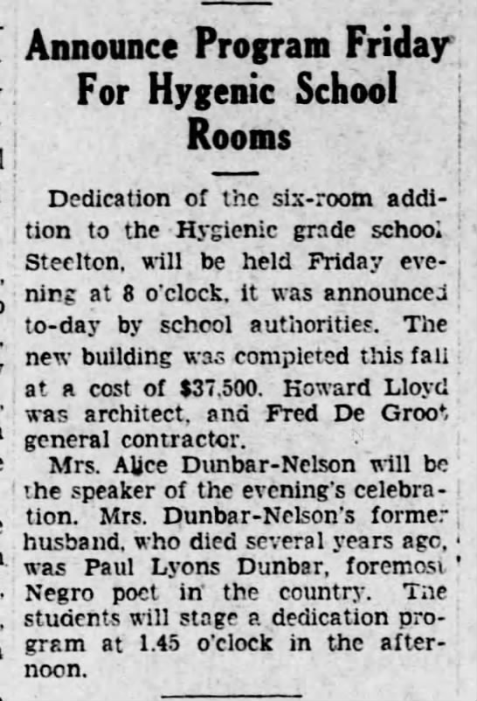
Howard Lloyd, architect for second Hygienic
Notes:
1-23-1929 addition of six rooms - Harrisburg Evening New

Slide 8
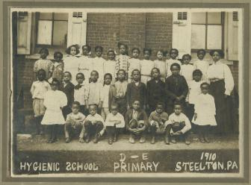
Primary class standing outside of original Hygienic School 1910
Notes:
Primary class standing outside of school 1910

Slide 9
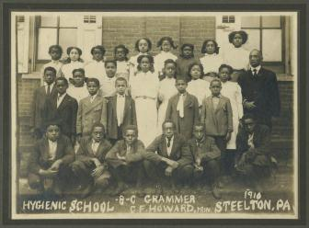
Grammer class of Hygienic 1916 with Prof. C.F.Howard, principal
Notes:
Professor Howard with children outside of school building 1916

Slide 10
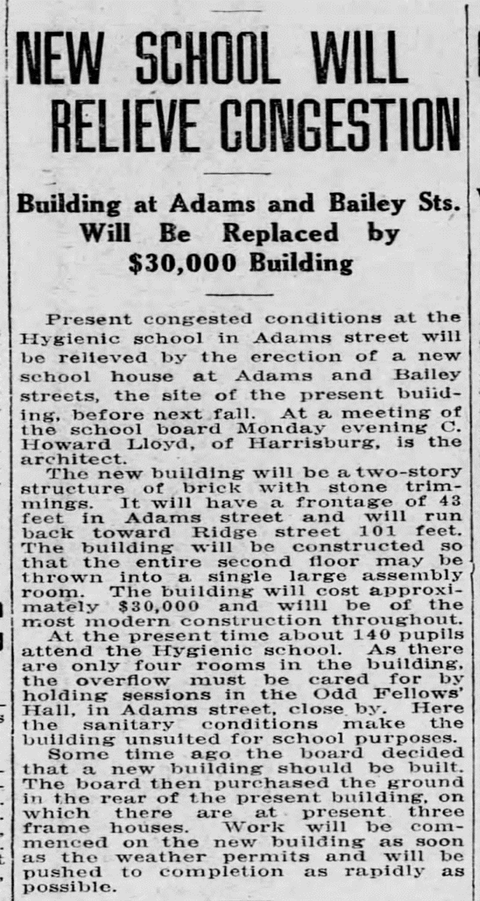
Notes:
1913 – Charles Howard Lloyd – two story replacement

Slide 11
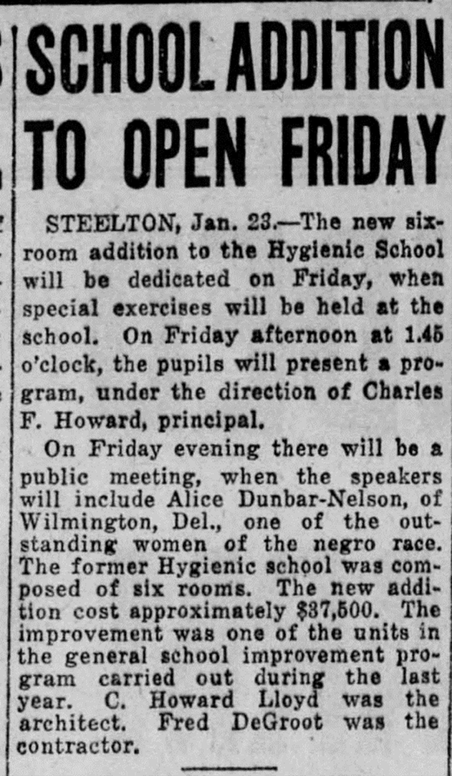
Notes:
1929 – six room addition by Charles Howard Lloyd

Slide 12
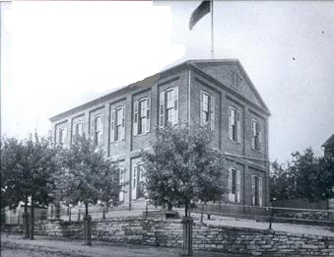
Hygienic School for Colored Children
Located at Adams and Bailey Streets.
Notes:
Smith architect – Adams and Bailey Streets

Slide 13
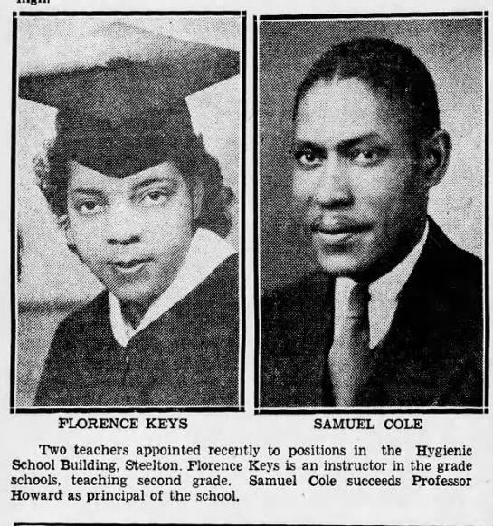
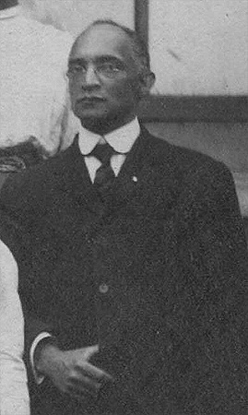
Professor Charles Howard
Principal of Hygienic School for fifty years.
Notes:
Principal of Hygienic School 1885-1936

Slide 14
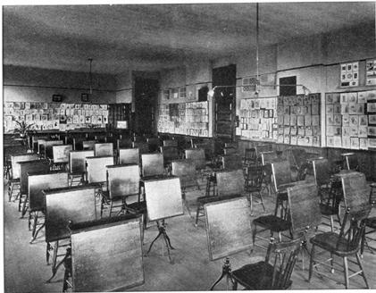
New Hygienic classroom
Notes:
Art room of the Hygienic – Charles Howard Lloyd architect

Slide 15
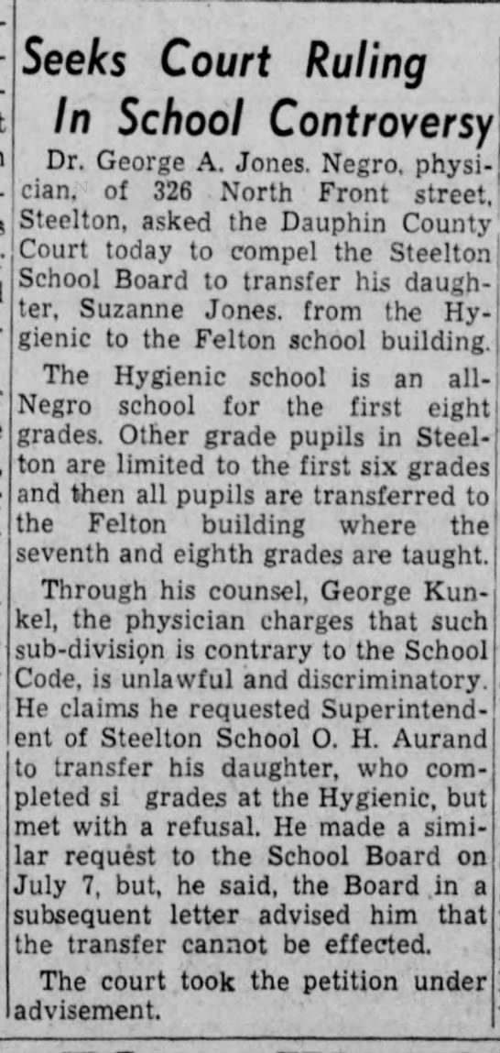
Story of young Suzanne

Slide 16
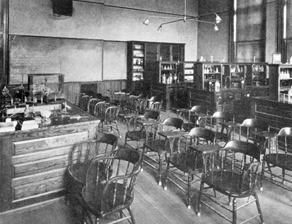
Science/lab classroom
Notes:
Till 1959 -Science and Lab classroom – notice the bottles on the shelves – Lloyd architect

Slide 17
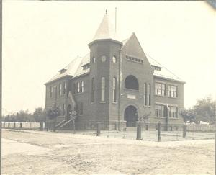
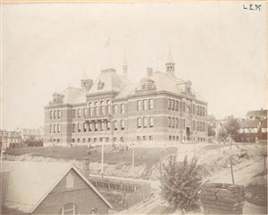
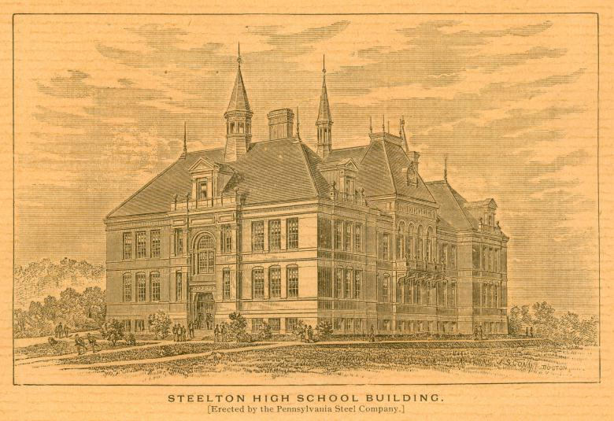
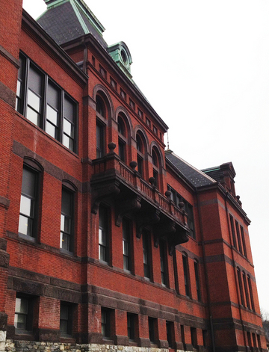
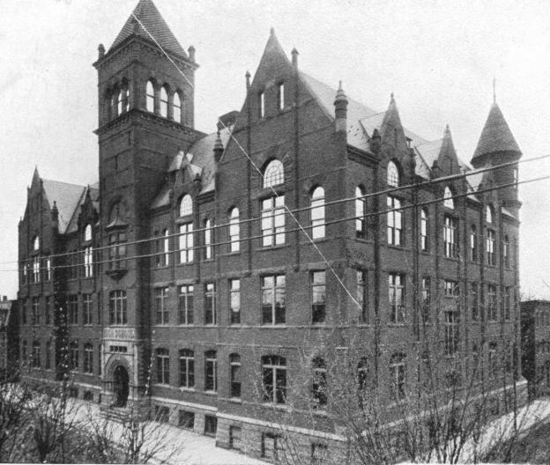
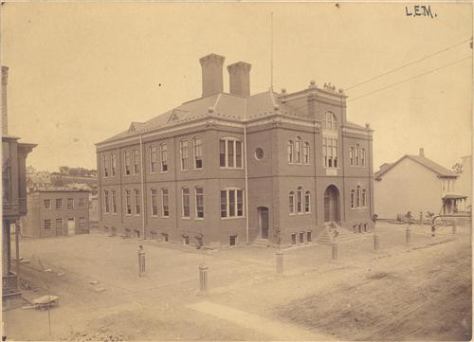
Schools in Steelton 1880’s
Notes:
Major Bent, Felton School, High School, West Side, Felton Building lofts

Slide 18
Hygienic produced teachers lawyers doctors ministers professors
Armed forces members and many wonderful people that served the community well.
Notes:
Head of Tuskegee Inst., Buffalo Soldier,

Slide 19
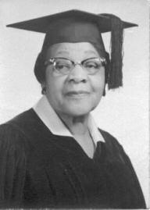
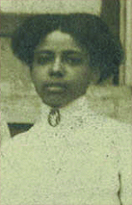
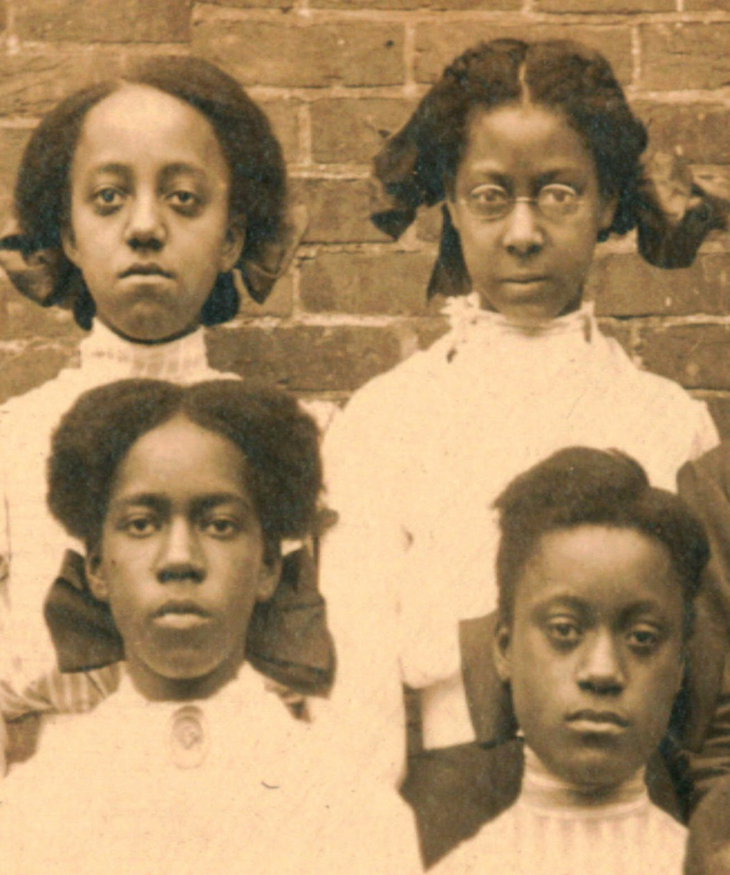
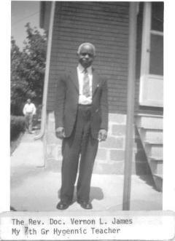
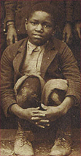
Faces of the Past
Notes:
Miss Imes, Rev Doc. Vernon James, Mrs. James, youth of the Hygienic

Slide 20
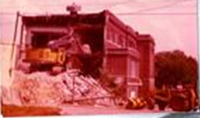
Hygienic demolished 1974
Notes:
The demolition of the school 1974

